Slide 1



Project Management
Dr Pieris Chourides (BEng,MSc, PhD)
Assistant Professor
Business School
European University Cyprus
p.chourides@euc.ac.cy
Digital Champion
January 2015

Slide 2




Project Management
Knowledge
Areas
PRICE $200
Characteristics
Skills
FOLLOW INSTRUCTIONS
ON TOP CARD
Understanding
Project
Management
?
Examples
Agenda
What Is a Project?
Project Attributes
What is Project Management?
The Triple Constraint
Knowledge Areas
Project Characteristics
Skills for Project Managers
Project Life Cycles and Their Effects
Quadruple Constraint of Project Success
How Does Project Management Benefit you?
Example
?
Life Cycle

Slide 3
What Is a Project?
A project is “a temporary endeavor undertaken to create a unique product, service, or result.”
Operations is work done to sustain the business.
A project ends when its objectives have been reached, or the project has been terminated.
Projects can be large or small and take a short or long time to complete.

Slide 4
Project Attributes
A project:
  Has a unique purpose.
  Is temporary.
  Is developed using progressive elaboration.
  Requires resources, often from various areas.
  Should have a primary customer or sponsor.
    The project sponsor usually provides the direction and funding for the project.
  Involves uncertainty.

Slide 5
What is Project Management?
Project management is “the application of knowledge, skills, tools and techniques to project activities to meet project requirements.”

Slide 6
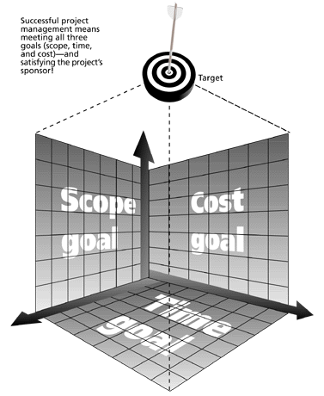
The Triple Constraint
Successful project management means meeting all three goals (scope, time, and cost) – and satisfying the project’s sponsor!

Slide 7
Knowledge Areas
Scope Management
Time Management
Cost Management
Quality Management
Human Resources Management
Communications Management
Risk Management
Procurement Management
Integration Management

Slide 8
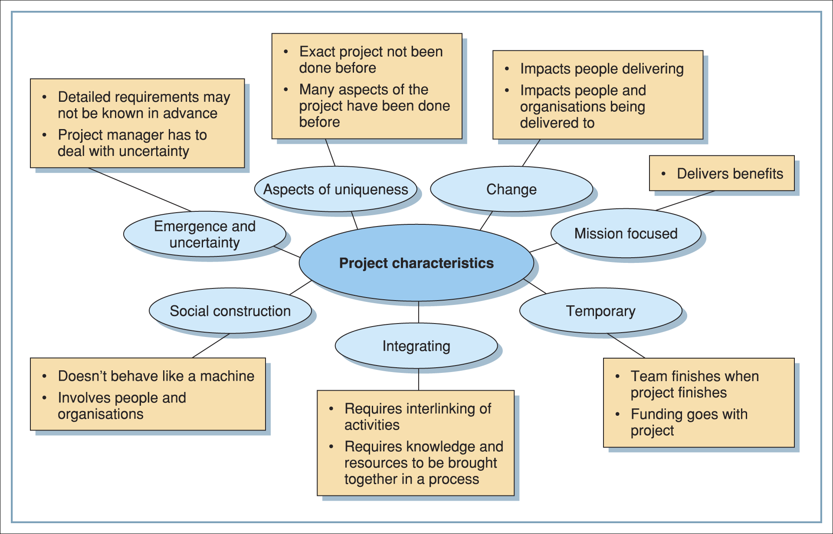
Project Characteristics

Slide 9
Skills for Project Managers
Communication skills: Listens, persuades.
Organizational skills: Plans, sets goals, analyzes.
Team-building skills: Shows empathy, motivates, promotes esprit de corps.
Leadership skills: Sets examples, provides vision (big picture), delegates, positive, energetic.
Coping skills: Flexible, creative, patient, persistent.
Technology skills: Experience, project knowledge.

Slide 10
Project Life Cycles and Their Effects
Client Interest
Project Stake
Resources
Creativity
Uncertainty
Conceptualization
Planning
Execution
Termination

Slide 11
How Does Project Management Benefit you?
You will have goal clarity and measurement
Your resources will be coordinated
Your risks will be identified and managed
You will increase the possibilities of time savings
You will increase the possibilities of cost savings
You will increase the possibilities of achieving the agreed outcome
You will increase the possibilities to deliver projects successfully
Notes:
11

Slide 12
Quadruple Constraint of Project Success
Client
Acceptance
Budget
Success
Schedule
Performance

Slide 13
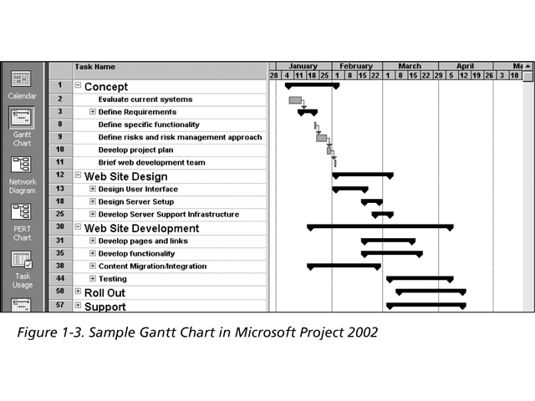
Gantt Chart
.

Slide 14
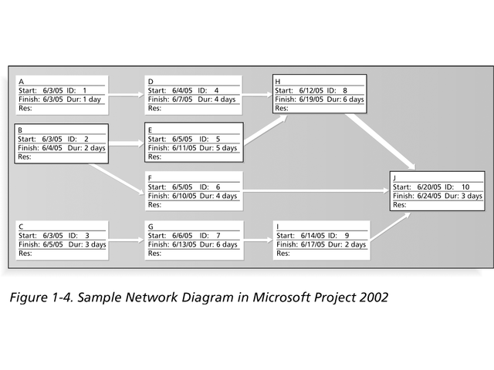
Network Diagram

Slide 15

Questions

