Slide 1


Training Day & Workshops
Saturday 31-Jan-2015
Software & Hardware by Andreas Grondoudis

Slide 2
Overview
The speaker
The entries
The software element
Hardware
Helpful tips and pointers
T
Wha
Nex

Slide 3

Briefly about the speaker
Andreas Grondoudis
From Thessaloniki, Greece
Studied and worked in the UK
Joined Cyprus College in 2003, and European University in 2007
Primary responsibilities include: Programming Principles, Networking, Technical Writing.
Who

Slide 4
Some numbers about the entries
Counted 54 in total
  28 in K3
  11 in K2
  15 in K1

Slide 5

The software element
Common to almost all entries
  For a standalone application
  For a mobile App
  For a website
  For an online platform
  For interfacing with the hardware
    Control
    Data acquisition & processing

Slide 6
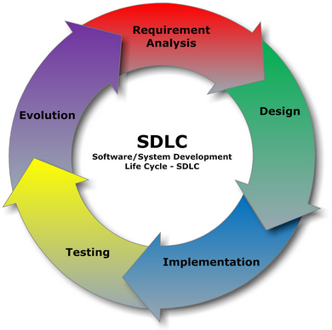
The software development life cycle
In (waterfall) theory straight forward
In practice you often need to backtrack
  Enhance after a prototype
  Correct a design flaw
  Satisfy altered (by client) requirements
  Fix bugs

Slide 7
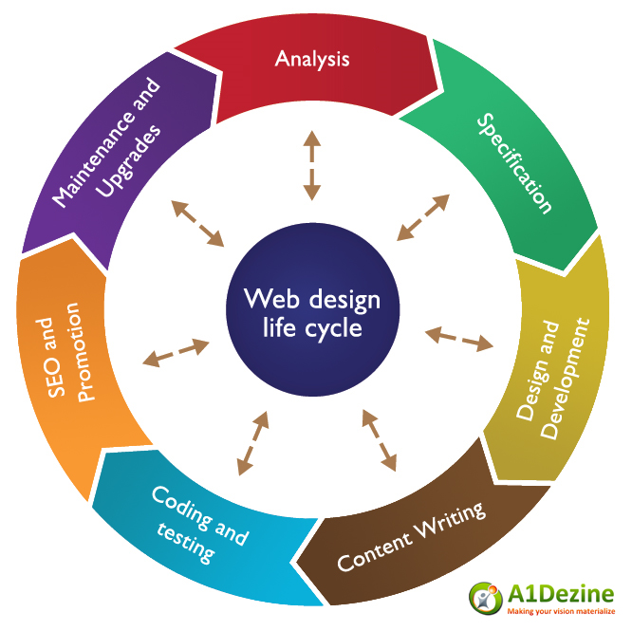
The website development cycle
Includes more steps
  Content writing
  Search Engine Optimization
  Marketing tools
Web development can also iterate on steps

Slide 8
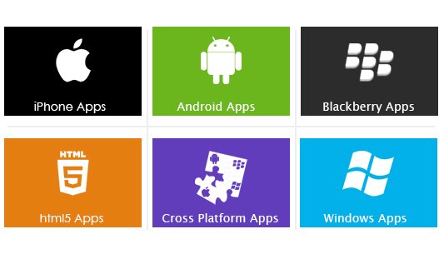
Smart development
More specific requirements
More focused applications
Trendy niches (like business intelligence)

Slide 9
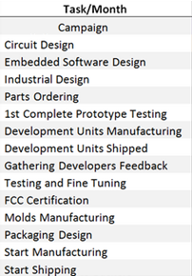
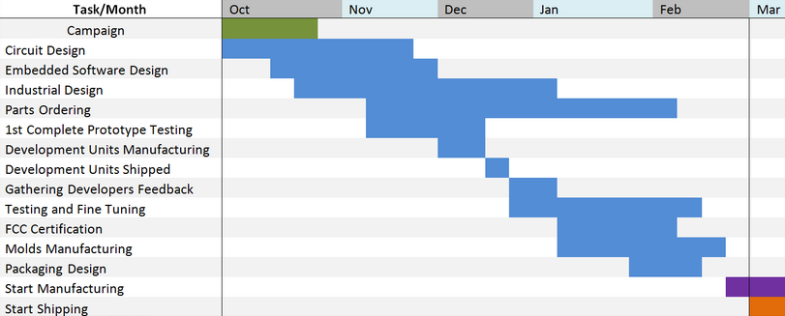
Hardware
Is more
  Challenging
  Demanding
  Rewarding
Development is analogous to software cycle

Slide 10
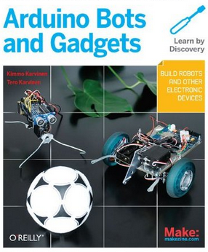
DIY Platforms & Trade offs
A few possibilities
  Arduino
  Raspberry Pie
Trade-offs
  Custom build vs ready-made
  Cost effective vs Complexity
  Budget vs delivery
  Time economizing

Slide 11
Work hard and be persistent
Stay focused on the idea, Work methodically, Design meticulously, and complete the solution; Be persistent, If things go wrong, try and try again
Henry Ford was left broke 5 times before he founded the Ford Motor Company | Soichiro Honda was rejected by Toyota for a job and started building his own scouters at home | Harland David Sanders had his chicken recipe rejected 1009 times | Walt Disney started a number of businesses that went south | Isaac Newton failed when put in charge of the family farm | Thomas Edison had 1000 failed attempts for the light bulb | The Wright Brothers worked for years, had lots of failed prototypes | Oprah Winfrey was fired from her television job as she was “unfit for tv” | Steven Spielberg was rejected from a film and television university 3 times | Michael Jordan was cut from his high school basketball team | The manager of the Grand Ole Opry, fired Elvis Presley telling him: “You ain’t goin’ nowhere son, You ought to go back to drivin’ a truck”

Slide 12
Thank you for you attention
A light lunch will follow
See you at 14:30 in the face-to-face workshops

