Slide 1
Improvements to
e-COST
28 June 2013
Brussels, Belgium

Slide 2
An Improved e-COST System
A new release of e-COST is being implemented on 28 June 2013 and will be followed by the revised COST Vademecum
The system has been improved in order to better enforce rules already in place, as well as reflect a number of revised rules now applicable to COST Actions Management Committees and COST Action Participants
This released will be accompanied by 3 “how to” guide explaining in detail the new functionalities.
2

Slide 3
Meetings
  The “Joint meeting” functionality has been improved. Co-located meetings are now easier to manage.
  The participation and eligibility of participants per meeting type is now automatically defined according to COST Rules.
  Changes will not affect meetings already created and will not affect participants already invited before the new release.
a

Slide 4
Online Travel Reimbursement Request (OTRR)
  Expense categories have been reorganised, allowing easier encoding by participants and easier review by Grant Holders
  OTRR modifications are now applicable both for meeting participants and trainers
  The improvements apply immediately for all participants who haven’t submitted their OTRR by 28 June 2013
m
4

Slide 5
Local Organiser Support
The application process has been redesigned and simplified
Online pre-approval and post-approval by the MC Chair/ Vice Chair is now possible
Grant Letters and Payment Request Forms, including breakdowns of expenses and invoices, can now be processed online
The new process applies as of the date of the release
For on-going claims/requests, the system will automatically redirect you to the corresponding step of the new process
No change in term of the eligibility of expenses

Slide 6
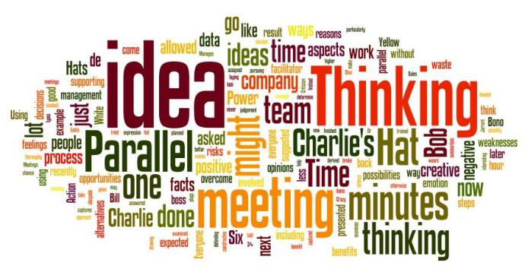
STSMs & Training Schools
The issuing of Grant Letters for STSM applicants and Trainees on Training schools has been simplified
  Improvements apply as of today to any new STSM or Training School

Slide 7
Any questions?
Please contact the Administrative Officer in charge of the Action
Thank you!

